Slide 1








Joint Multisided Exposure Fairness for Search and Recommendation
Joint work with Haolun Wu, Chen Ma, Fernando Diaz, and Xue Liu
Bhaskar Mitra
Principal Researcher, Microsoft Research
@UnderdogGeek bmitra@microsoft.com

Slide 2
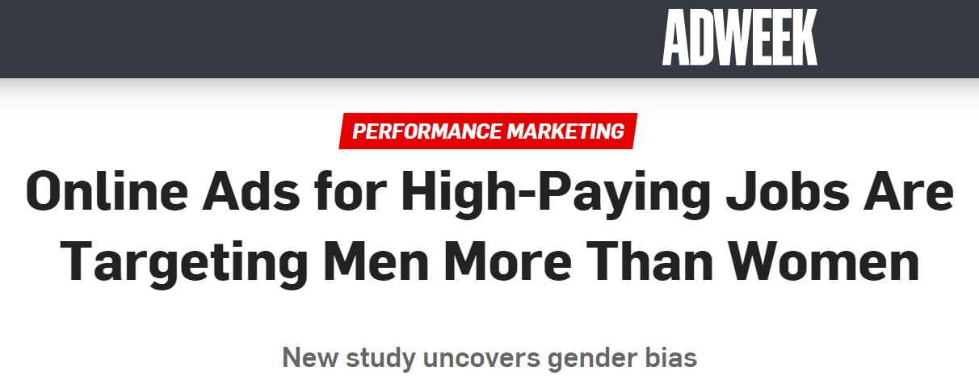
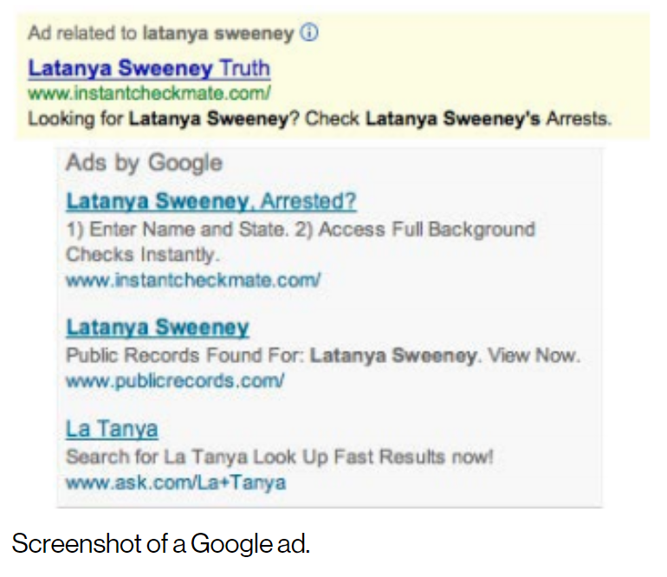
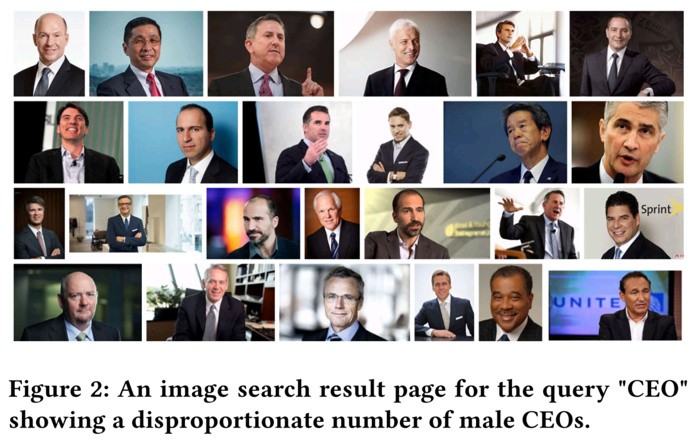
Harms of disparate exposure
Traditional IR is concerned with ranking items according to relevance; These information access systems deployed at web-scale mediate what information gets exposure
Several past studies have pointed out allocative and representational harms from disparate exposure
The exposure-framing of IR presents new opportunities and challenges to optimize retrieval systems towards user satisfaction at the level of both individuals and different subpopulations
Sweeney. Discrimination in online ad delivery. Commun. ACM. (2013)
Crawford. The Trouble with Bias. NeurIPS. (2017)
Singh and Joachims. Fairness of Exposure in Rankings. In KDD, ACM. (2018)

Slide 3
Exposure fairness is a multisided problem
It is important to ask not just whether specific content receives exposure, but who it is exposed to and in what context
Haolun, Mitra, Ma, and Liu. Joint Multisided Exposure Fairness for Recommendation. In SIGIR, ACM. (2022)

Slide 4




Exposure fairness is a multisided problem
Take the example of a job recommendation system
Individual-user-to-Individual-item fairness (II-F)
Are Individual items under/over-exposed to Individual users?
Individual-user-to-group-of-items fairness (IG-F)
Are groups of items under/over-exposed to individual users?
E.g., a specific user being disproportionately recommended low-paying jobs.
Group-of-users-to-Individual-item fairness (GI-F)
Are Individual items under/over-exposed to groups of users?
E.g., a specific job being disproportionately recommended to men and not to women and non-binary people.
Group-of-users-to-group-of-items fairness (GG-F)
Are groups of items under/over-exposed to groups of users?
E.g., men being disproportionately recommended high-paying jobs and women low-paying jobs.
All-users-to-Individual-item fairness (AI-F)
Are Individual items under/over-exposed to all users overall?
E.g., a specific job being disproportionately under-exposed to all users.
All-users-to-group-of-items fairness (AG-F)
Are groups of items under/over-exposed to all users overall?
E.g., jobs at Black-owned businesses being disproportionately under-exposed to all users.

Slide 5
Exposure fairness is a multisided problem
Take the example of a job recommendation system
Individual-user-to-Individual-item fairness (II-F)
Are Individual items under/over-exposed to Individual users?
Individual-user-to-group-of-items fairness (IG-F)
Are groups of items under/over-exposed to individual users?
E.g., a specific user being disproportionately recommended low-paying jobs.
Group-of-users-to-Individual-item fairness (GI-F)
Are Individual items under/over-exposed to groups of users?
E.g., a specific job being disproportionately recommended to men and not to women and non-binary people.
Group-of-users-to-group-of-items fairness (GG-F)
Are groups of items under/over-exposed to groups of users?
E.g., men being disproportionately recommended high-paying jobs and women low-paying jobs.
All-users-to-Individual-item fairness (AI-F)
Are Individual items under/over-exposed to all users overall?
E.g., a specific job being disproportionately under-exposed to all users.
All-users-to-group-of-items fairness (AG-F)
Are groups of items under/over-exposed to all users overall?
E.g., jobs at Black-owned businesses being disproportionately under-exposed to all users.

Slide 6
Exposure fairness is a multisided problem
Take the example of a job recommendation system
Individual-user-to-Individual-item fairness (II-F)
Are Individual items under/over-exposed to Individual users?
Individual-user-to-group-of-items fairness (IG-F)
Are groups of items under/over-exposed to individual users?
E.g., a specific user being disproportionately recommended low-paying jobs.
Group-of-users-to-Individual-item fairness (GI-F)
Are Individual items under/over-exposed to groups of users?
E.g., a specific job being disproportionately recommended to men and not to women and non-binary people.
Group-of-users-to-group-of-items fairness (GG-F)
Are groups of items under/over-exposed to groups of users?
E.g., men being disproportionately recommended high-paying jobs and women low-paying jobs.
All-users-to-Individual-item fairness (AI-F)
Are Individual items under/over-exposed to all users overall?
E.g., a specific job being disproportionately under-exposed to all users.
All-users-to-group-of-items fairness (AG-F)
Are groups of items under/over-exposed to all users overall?
E.g., jobs at Black-owned businesses being disproportionately under-exposed to all users.

Slide 7
Exposure fairness is a multisided problem
Take the example of a job recommendation system
Individual-user-to-Individual-item fairness (II-F)
Are Individual items under/over-exposed to Individual users?
Individual-user-to-group-of-items fairness (IG-F)
Are groups of items under/over-exposed to individual users?
E.g., a specific user being disproportionately recommended low-paying jobs.
Group-of-users-to-Individual-item fairness (GI-F)
Are Individual items under/over-exposed to groups of users?
E.g., a specific job being disproportionately recommended to men and not to women and non-binary people.
Group-of-users-to-group-of-items fairness (GG-F)
Are groups of items under/over-exposed to groups of users?
E.g., men being disproportionately recommended high-paying jobs and women low-paying jobs.
All-users-to-Individual-item fairness (AI-F)
Are Individual items under/over-exposed to all users overall?
E.g., a specific job being disproportionately under-exposed to all users.
All-users-to-group-of-items fairness (AG-F)
Are groups of items under/over-exposed to all users overall?
E.g., jobs at Black-owned businesses being disproportionately under-exposed to all users.

Slide 8
Exposure fairness is a multisided problem
Take the example of a job recommendation system
Individual-user-to-Individual-item fairness (II-F)
Are Individual items under/over-exposed to Individual users?
Individual-user-to-group-of-items fairness (IG-F)
Are groups of items under/over-exposed to individual users?
E.g., a specific user being disproportionately recommended low-paying jobs.
Group-of-users-to-Individual-item fairness (GI-F)
Are Individual items under/over-exposed to groups of users?
E.g., a specific job being disproportionately recommended to men and not to women and non-binary people.
Group-of-users-to-group-of-items fairness (GG-F)
Are groups of items under/over-exposed to groups of users?
E.g., men being disproportionately recommended high-paying jobs and women low-paying jobs.
All-users-to-Individual-item fairness (AI-F)
Are Individual items under/over-exposed to all users overall?
E.g., a specific job being disproportionately under-exposed to all users.
All-users-to-group-of-items fairness (AG-F)
Are groups of items under/over-exposed to all users overall?
E.g., jobs at Black-owned businesses being disproportionately under-exposed to all users.

Slide 9
Exposure fairness is a multisided problem
Take the example of a job recommendation system
Individual-user-to-Individual-item fairness (II-F)
Are Individual items under/over-exposed to Individual users?
Individual-user-to-group-of-items fairness (IG-F)
Are groups of items under/over-exposed to individual users?
E.g., a specific user being disproportionately recommended low-paying jobs.
Group-of-users-to-Individual-item fairness (GI-F)
Are Individual items under/over-exposed to groups of users?
E.g., a specific job being disproportionately recommended to men and not to women and non-binary people.
Group-of-users-to-group-of-items fairness (GG-F)
Are groups of items under/over-exposed to groups of users?
E.g., men being disproportionately recommended high-paying jobs and women low-paying jobs.
All-users-to-Individual-item fairness (AI-F)
Are Individual items under/over-exposed to all users overall?
E.g., a specific job being disproportionately under-exposed to all users.
All-users-to-group-of-items fairness (AG-F)
Are groups of items under/over-exposed to all users overall?
E.g., jobs at Black-owned businesses being disproportionately under-exposed to all users.

Slide 10
Exposure fairness is a multisided problem
Take the example of a job recommendation system
Individual-user-to-Individual-item fairness (II-F)
Are Individual items under/over-exposed to Individual users?
Individual-user-to-group-of-items fairness (IG-F)
Are groups of items under/over-exposed to individual users?
E.g., a specific user being disproportionately recommended low-paying jobs.
Group-of-users-to-Individual-item fairness (GI-F)
Are Individual items under/over-exposed to groups of users?
E.g., a specific job being disproportionately recommended to men and not to women and non-binary people.
Group-of-users-to-group-of-items fairness (GG-F)
Are groups of items under/over-exposed to groups of users?
E.g., men being disproportionately recommended high-paying jobs and women low-paying jobs.
All-users-to-Individual-item fairness (AI-F)
Are Individual items under/over-exposed to all users overall?
E.g., a specific job being disproportionately under-exposed to all users.
All-users-to-group-of-items fairness (AG-F)
Are groups of items under/over-exposed to all users overall?
E.g., jobs at Black-owned businesses being disproportionately under-exposed to all users.

Slide 11
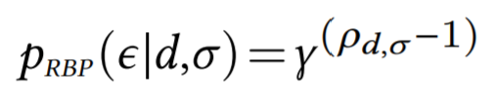
User browsing models and exposure
User browsing models are simplified models of how users inspect and interact with retrieved results
It estimates the probability that the user inspects a particular item in a ranked list of items—i.e., the item is exposed to the user
In IR, user models have been implicitly and explicitly employed in metric definitions and for estimating relevance from historical logs of user behavior data
For example, let’s consider the RBP user model…
RBP
NDCG
Probability of exposure at different ranks according to NDCG and RBP user browsing models
exposure event
rank of the item in the ranked list
an item
patience factor
a ranked list of items

Slide 12
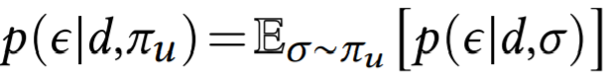
Stochastic ranking and expected exposure
In recommendation, Diaz et al. (2020) define a stochastic ranking policy 𝜋_{𝑢}, conditioned on user 𝑢 ∈ U, as a probability distribution over all permutations of items in the collection
The expected exposure of an item 𝑑 for user 𝑢 can then be computed as follows:
Here, 𝑝(𝜖|𝑑,𝜎) can be computed using a user browsing model like RBP as discussed previously
Note: The above formulation can also be applied to search by replacing user with query
Diaz, Mitra, Ekstrand, Biega, and Carterette. Evaluating stochastic rankings with expected exposure. In CIKM, ACM. (2020)

Slide 13
System, target, and random exposure
System exposure. The user-item expected exposure distribution corresponding to a stochastic ranking policy 𝜋. Correspondingly, we can define a |U|×|D| matrix E, such that E_{𝑖𝑗} = 𝑝(𝜖|D_{𝑗} ,𝜋_{U𝑖}).
Target exposure. The user-item expected exposure distribution corresponding to an ideal stochastic ranking policy 𝜋*, as defined by some desirable principle (e.g., the equal expected exposure principle). We denote the corresponding expected exposure matrix as E*.
Random exposure. The user-item expected exposure distribution corresponding to a stochastic ranking policy 𝜋~ that samples rankings from a uniform distribution over all item permutations. We denote the corresponding expected exposure matrix as E~.
The deviation of E from E* gives us a quantitative measure of the suboptimality of the retrieval system under consideration.

Slide 14
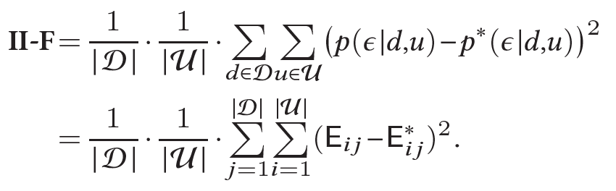
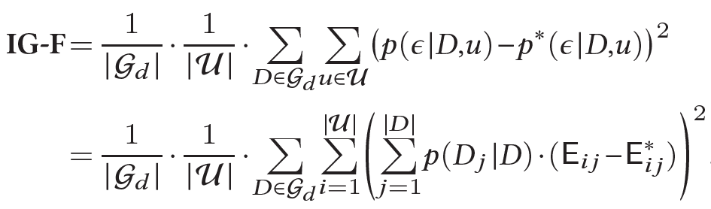
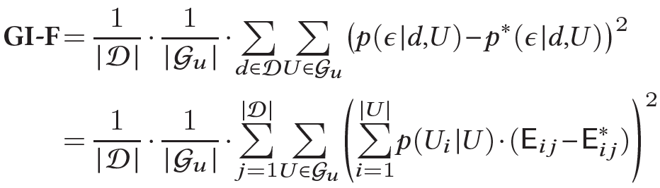
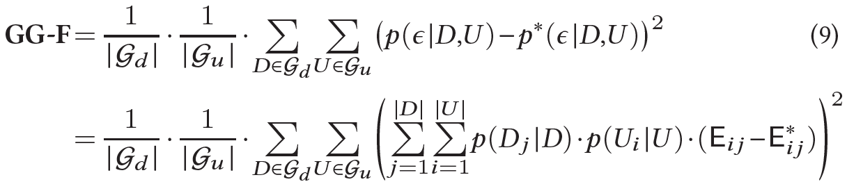
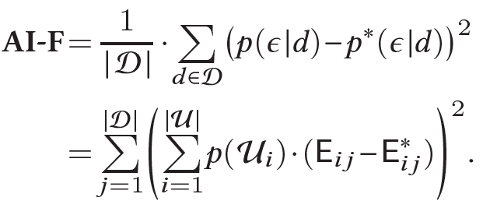
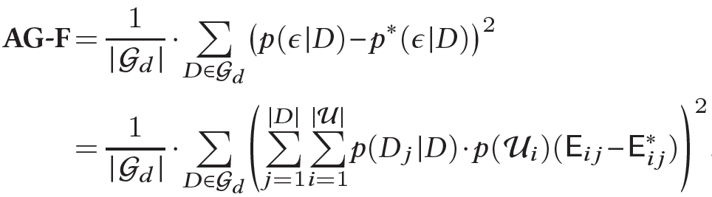
Joint multisided exposure (JME) fairness metrics
Haolun, Mitra, Ma, and Liu. Joint Multisided Exposure Fairness for Recommendation. In SIGIR, ACM. (2022)

Slide 15
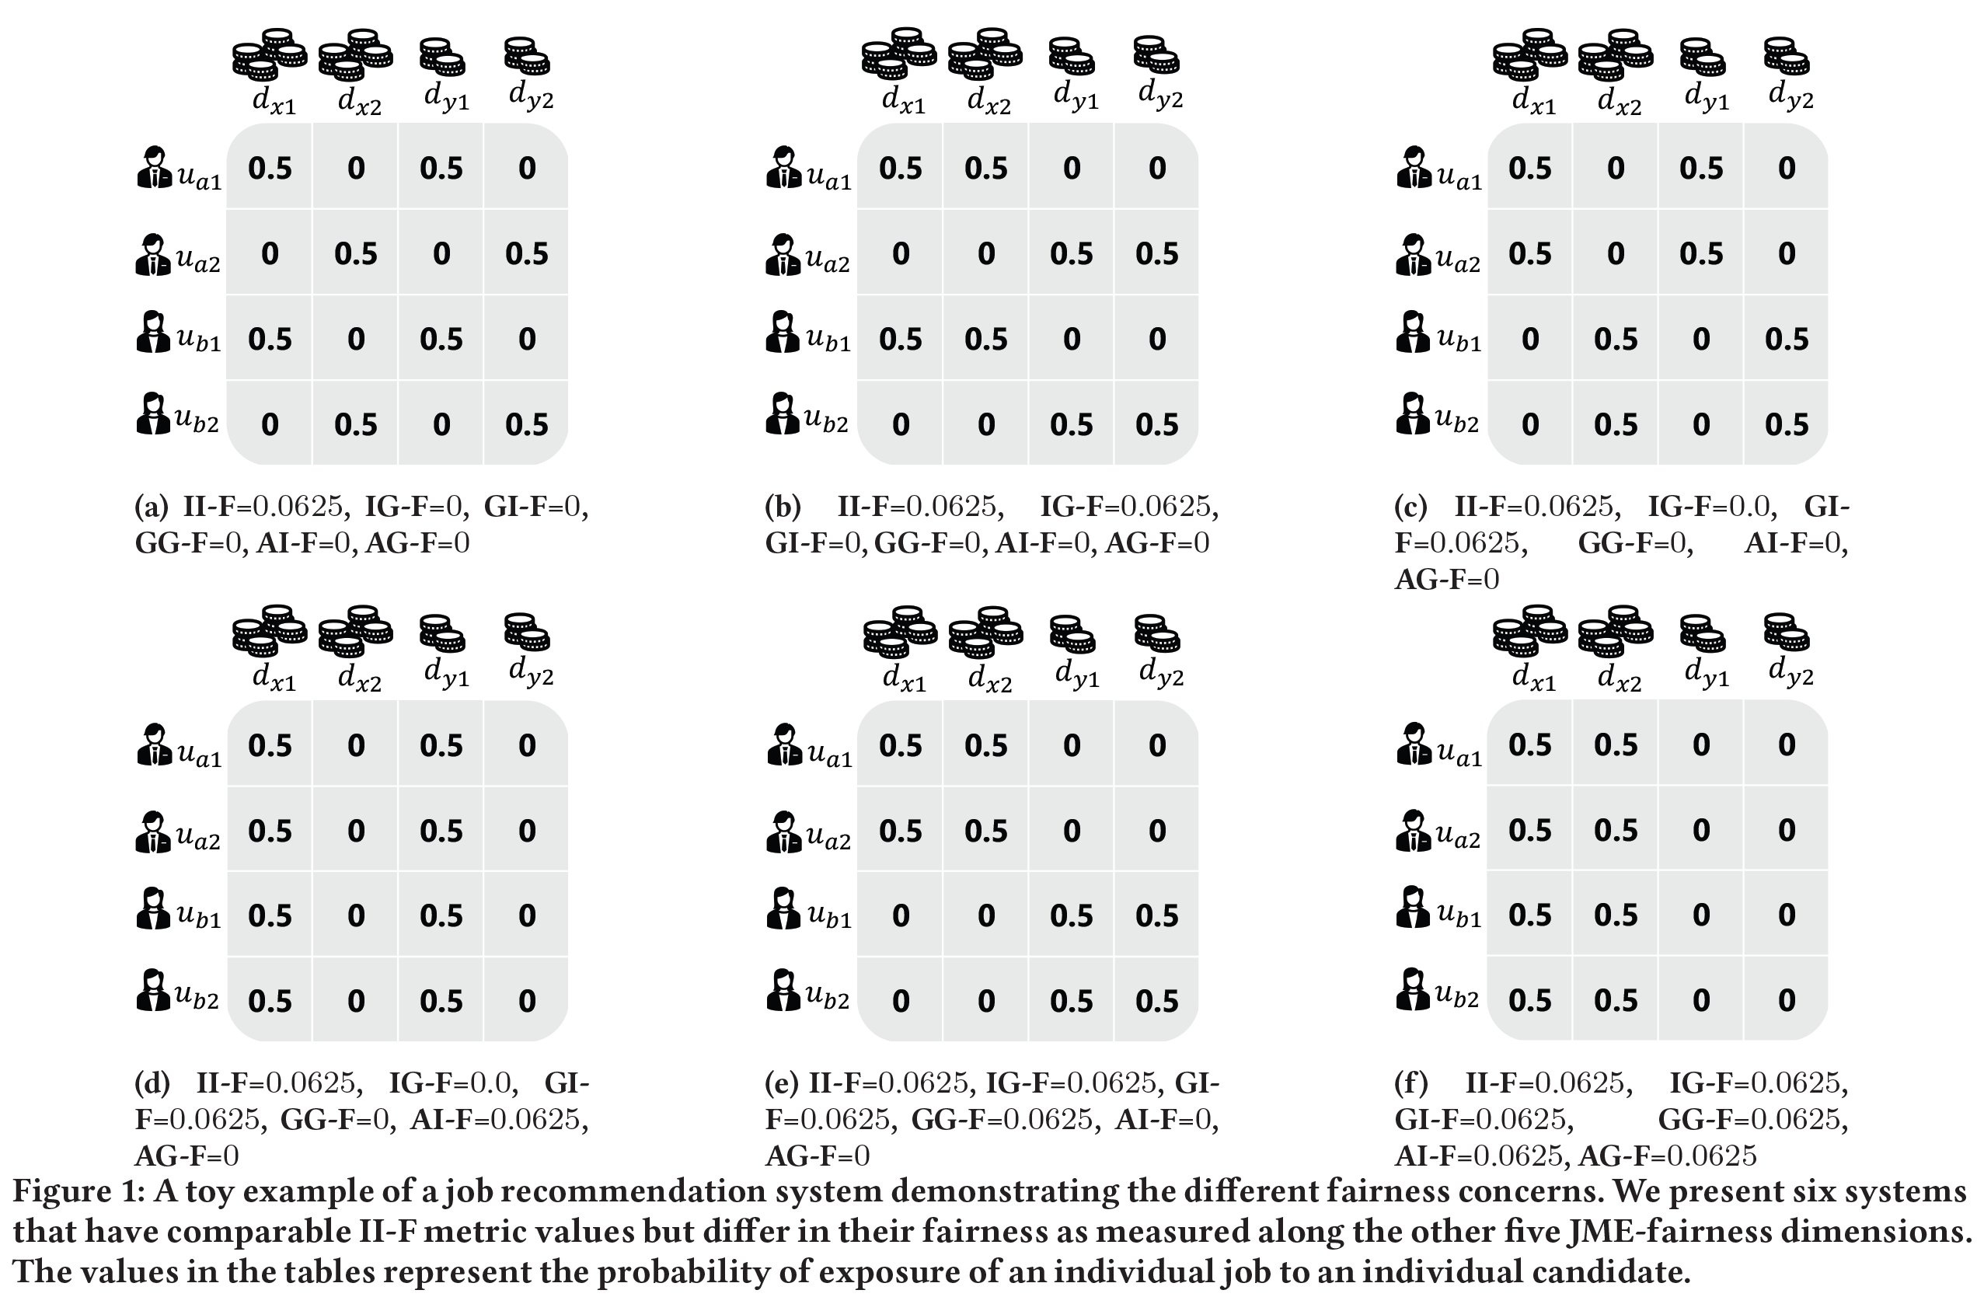
Toy example
Let, there be 4 candidates (𝑢_{𝑎1}, 𝑢_{𝑎2}, 𝑢_{𝑏1}, 𝑢_{𝑏2}) and 4 jobs (𝑑_{𝑥1}, 𝑑_{𝑥2}, 𝑑_{𝑦1}, 𝑑_{𝑦2})
All 4 jobs are relevant to each of the 4 candidates
The candidates belong to 2 groups 𝑎 (𝑢_{𝑎1}, 𝑢_{𝑎2}) and 𝑏 (𝑢_{𝑏1}, 𝑢_{𝑏2})—e.g., based on gender—and similarly the jobs belong to 2 groups 𝑥 (𝑑_{𝑥1}, 𝑑_{𝑥2}) and 𝑦 (𝑑_{𝑦1}, 𝑑_{𝑦2})—say based on whether they pay high or low salaries
Let’s assume that the recommender system displays only one result at a time and our simple user model assumes that the user always inspects the displayed result—i.e., the probability of exposure is 1 for the displayed item and 0 for all other items for a given impression
In this setting, an ideal recommender should expose each of the four jobs to each candidate with a probability of 0.25

Slide 16
Toy example
Let, there be 4 candidates (𝑢_{𝑎1}, 𝑢_{𝑎2}, 𝑢_{𝑏1}, 𝑢_{𝑏2}) and 4 jobs (𝑑_{𝑥1}, 𝑑_{𝑥2}, 𝑑_{𝑦1}, 𝑑_{𝑦2})
All 4 jobs are relevant to each of the 4 candidates
The candidates belong to 2 groups 𝑎 (𝑢_{𝑎1}, 𝑢_{𝑎2}) and 𝑏 (𝑢_{𝑏1}, 𝑢_{𝑏2})—e.g., based on gender—and similarly the jobs belong to 2 groups 𝑥 (𝑑_{𝑥1}, 𝑑_{𝑥2}) and 𝑦 (𝑑_{𝑦1}, 𝑑_{𝑦2})—say based on whether they pay high or low salaries
Let’s assume that the recommender system displays only one result at a time and our simple user model assumes that the user always inspects the displayed result—i.e., the probability of exposure is 1 for the displayed item and 0 for all other items for a given impression
In this setting, an ideal recommender should expose each of the four jobs to each candidate with a probability of 0.25
All of them are equally II-Unfair

Slide 17
Toy example
Let, there be 4 candidates (𝑢_{𝑎1}, 𝑢_{𝑎2}, 𝑢_{𝑏1}, 𝑢_{𝑏2}) and 4 jobs (𝑑_{𝑥1}, 𝑑_{𝑥2}, 𝑑_{𝑦1}, 𝑑_{𝑦2})
All 4 jobs are relevant to each of the 4 candidates
The candidates belong to 2 groups 𝑎 (𝑢_{𝑎1}, 𝑢_{𝑎2}) and 𝑏 (𝑢_{𝑏1}, 𝑢_{𝑏2})—e.g., based on gender—and similarly the jobs belong to 2 groups 𝑥 (𝑑_{𝑥1}, 𝑑_{𝑥2}) and 𝑦 (𝑑_{𝑦1}, 𝑑_{𝑦2})—say based on whether they pay high or low salaries
Let’s assume that the recommender system displays only one result at a time and our simple user model assumes that the user always inspects the displayed result—i.e., the probability of exposure is 1 for the displayed item and 0 for all other items for a given impression
In this setting, an ideal recommender should expose each of the four jobs to each candidate with a probability of 0.25
Only (b), (e), and (f) are IG-Unfair

Slide 18
Toy example
Let, there be 4 candidates (𝑢_{𝑎1}, 𝑢_{𝑎2}, 𝑢_{𝑏1}, 𝑢_{𝑏2}) and 4 jobs (𝑑_{𝑥1}, 𝑑_{𝑥2}, 𝑑_{𝑦1}, 𝑑_{𝑦2})
All 4 jobs are relevant to each of the 4 candidates
The candidates belong to 2 groups 𝑎 (𝑢_{𝑎1}, 𝑢_{𝑎2}) and 𝑏 (𝑢_{𝑏1}, 𝑢_{𝑏2})—e.g., based on gender—and similarly the jobs belong to 2 groups 𝑥 (𝑑_{𝑥1}, 𝑑_{𝑥2}) and 𝑦 (𝑑_{𝑦1}, 𝑑_{𝑦2})—say based on whether they pay high or low salaries
Let’s assume that the recommender system displays only one result at a time and our simple user model assumes that the user always inspects the displayed result—i.e., the probability of exposure is 1 for the displayed item and 0 for all other items for a given impression
In this setting, an ideal recommender should expose each of the four jobs to each candidate with a probability of 0.25
Only (c), (d), (e), and (f) are GI-Unfair

Slide 19
Toy example
Let, there be 4 candidates (𝑢_{𝑎1}, 𝑢_{𝑎2}, 𝑢_{𝑏1}, 𝑢_{𝑏2}) and 4 jobs (𝑑_{𝑥1}, 𝑑_{𝑥2}, 𝑑_{𝑦1}, 𝑑_{𝑦2})
All 4 jobs are relevant to each of the 4 candidates
The candidates belong to 2 groups 𝑎 (𝑢_{𝑎1}, 𝑢_{𝑎2}) and 𝑏 (𝑢_{𝑏1}, 𝑢_{𝑏2})—e.g., based on gender—and similarly the jobs belong to 2 groups 𝑥 (𝑑_{𝑥1}, 𝑑_{𝑥2}) and 𝑦 (𝑑_{𝑦1}, 𝑑_{𝑦2})—say based on whether they pay high or low salaries
Let’s assume that the recommender system displays only one result at a time and our simple user model assumes that the user always inspects the displayed result—i.e., the probability of exposure is 1 for the displayed item and 0 for all other items for a given impression
In this setting, an ideal recommender should expose each of the four jobs to each candidate with a probability of 0.25
Only (e) and (f) are GG-Unfair

Slide 20
Toy example
Let, there be 4 candidates (𝑢_{𝑎1}, 𝑢_{𝑎2}, 𝑢_{𝑏1}, 𝑢_{𝑏2}) and 4 jobs (𝑑_{𝑥1}, 𝑑_{𝑥2}, 𝑑_{𝑦1}, 𝑑_{𝑦2})
All 4 jobs are relevant to each of the 4 candidates
The candidates belong to 2 groups 𝑎 (𝑢_{𝑎1}, 𝑢_{𝑎2}) and 𝑏 (𝑢_{𝑏1}, 𝑢_{𝑏2})—e.g., based on gender—and similarly the jobs belong to 2 groups 𝑥 (𝑑_{𝑥1}, 𝑑_{𝑥2}) and 𝑦 (𝑑_{𝑦1}, 𝑑_{𝑦2})—say based on whether they pay high or low salaries
Let’s assume that the recommender system displays only one result at a time and our simple user model assumes that the user always inspects the displayed result—i.e., the probability of exposure is 1 for the displayed item and 0 for all other items for a given impression
In this setting, an ideal recommender should expose each of the four jobs to each candidate with a probability of 0.25
Only (d) and (f) are AI-Unfair

Slide 21
Toy example
Let, there be 4 candidates (𝑢_{𝑎1}, 𝑢_{𝑎2}, 𝑢_{𝑏1}, 𝑢_{𝑏2}) and 4 jobs (𝑑_{𝑥1}, 𝑑_{𝑥2}, 𝑑_{𝑦1}, 𝑑_{𝑦2})
All 4 jobs are relevant to each of the 4 candidates
The candidates belong to 2 groups 𝑎 (𝑢_{𝑎1}, 𝑢_{𝑎2}) and 𝑏 (𝑢_{𝑏1}, 𝑢_{𝑏2})—e.g., based on gender—and similarly the jobs belong to 2 groups 𝑥 (𝑑_{𝑥1}, 𝑑_{𝑥2}) and 𝑦 (𝑑_{𝑦1}, 𝑑_{𝑦2})—say based on whether they pay high or low salaries
Let’s assume that the recommender system displays only one result at a time and our simple user model assumes that the user always inspects the displayed result—i.e., the probability of exposure is 1 for the displayed item and 0 for all other items for a given impression
In this setting, an ideal recommender should expose each of the four jobs to each candidate with a probability of 0.25
Only (f) is AG-Unfair

Slide 22
Relationship between different JME metrics
II-F=0
All the other metrics can be viewed as specific instances of GG-F, with different (extreme) definitions of groups on user and item side
Based on the metric definitions, we can show that a system that is II-Fair (i.e., II-F=0) will also be fair along the other five JME-fairness dimensions
Similarly, IG-Fair and GI-Fair independently implies GG-Fair, and GG-Fair and AI-Fair implies AG-Fair
IG-F=0
GI-F=0
GG-F=0
AI-F=0
AG-F=0

Slide 23
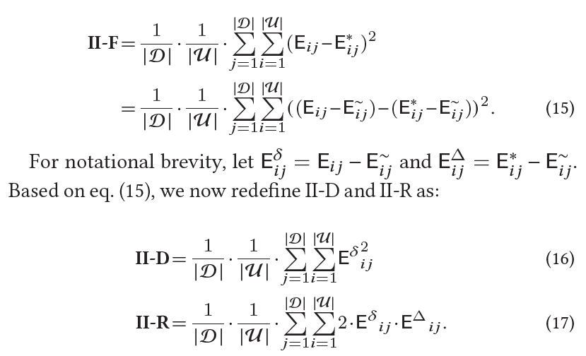
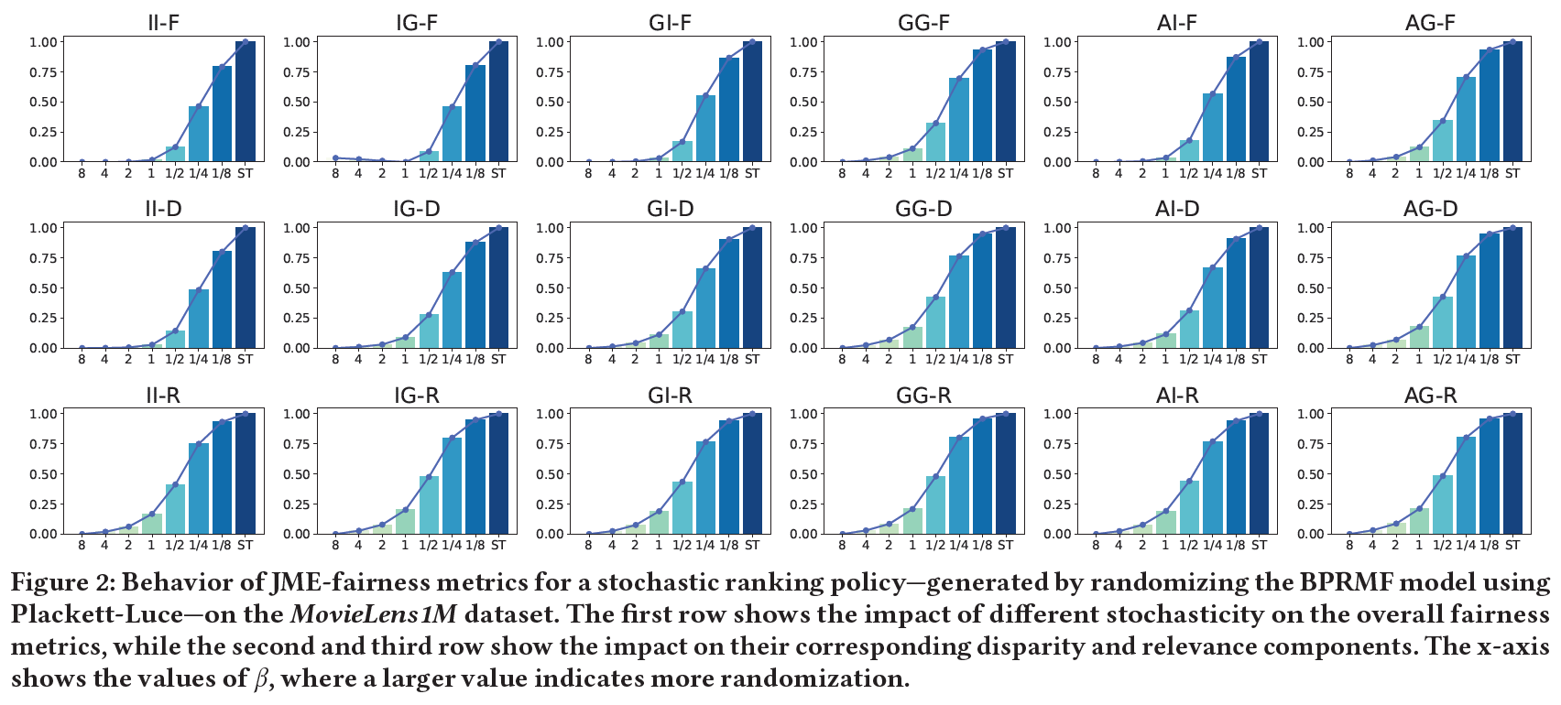
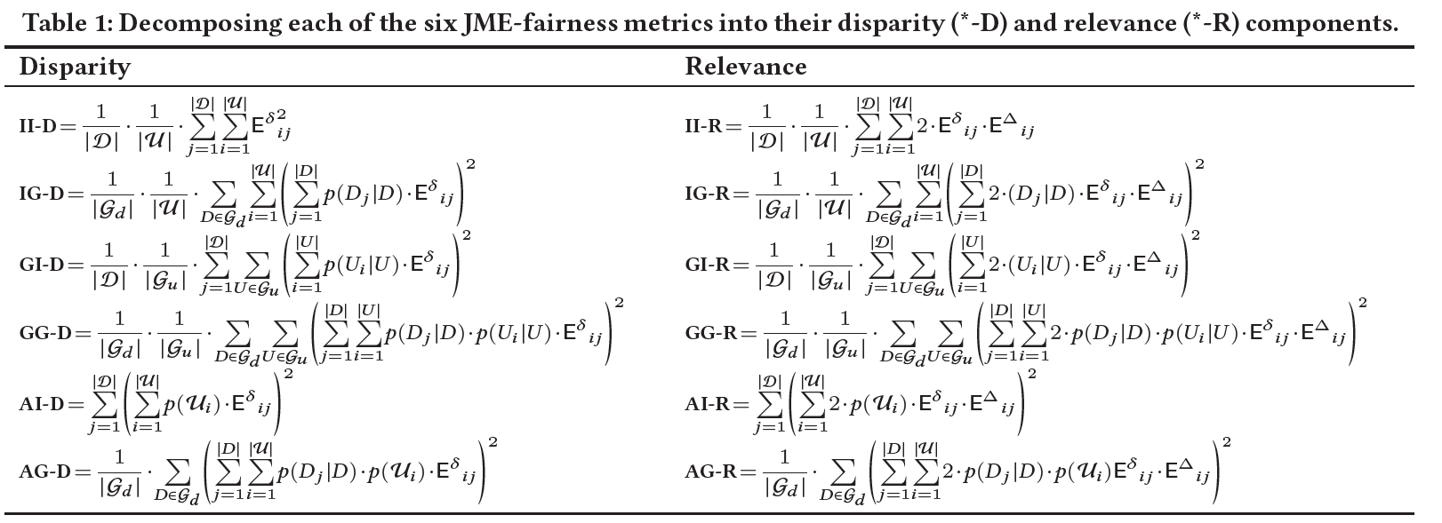
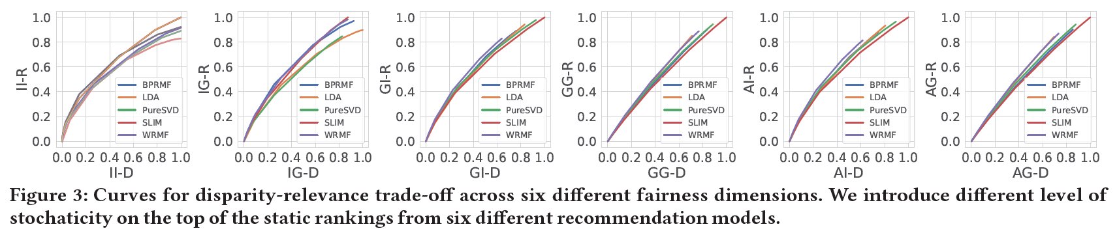
Disparity and relevance
Each of our proposed JME-fairness metrics can be decomposed into a disparity and a relevance component, such that increasing randomness in the model would decrease disparity (good!) but also decrease relevance (bad!)
Different models have different disparity-relevance trade-off for each of the different JME-fairness metrics

Slide 24
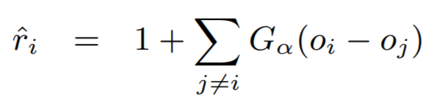
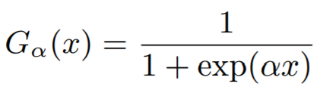
Gradient-based optimization for target exposure
Approach
Challenges and solutions
Use the target model to score the items
Compute PL sampling probability as a function of the item scores
Sample multiple rankings
Compute expected system exposure across sampled rankings
Compute the loss as a difference between system and target exposure
Backpropagate!
The key challenge is the proposed approach is that both the sampling and the ranking steps are non-differentiable!
For sampling, we can use Gumbel sampling as a differentiable approximation
For ranking, we can employ SmoothRank / ApproxRank as differentiable approximations of the ranking step
,
Wu, Chang, Zheng, and Zha. Smoothing DCG for learning to rank: A novel approach using smoothed hinge functions. In Proc. CIKM, ACM. (2009)
Qin, Liu, and Li. A general approximation framework for direct optimization of information retrieval measures. Information retrieval. (2010)
Bruch, Han, Bendersky, and Najork. A stochastic treatment of learning to rank scoring functions. In Proc. WSDM, ACM. (2020)

Slide 25








Gradient-based optimization for target exposure
items
neural scoring function
add independently sampled Gumbel noise
compute smooth rank value
compute exposure using user model
compute average exposure
compute loss with target exposure
target exposure
Diaz, Mitra, Ekstrand, Biega, and Carterette. Evaluating stochastic rankings with expected exposure. In CIKM, ACM. (2020)

Slide 26
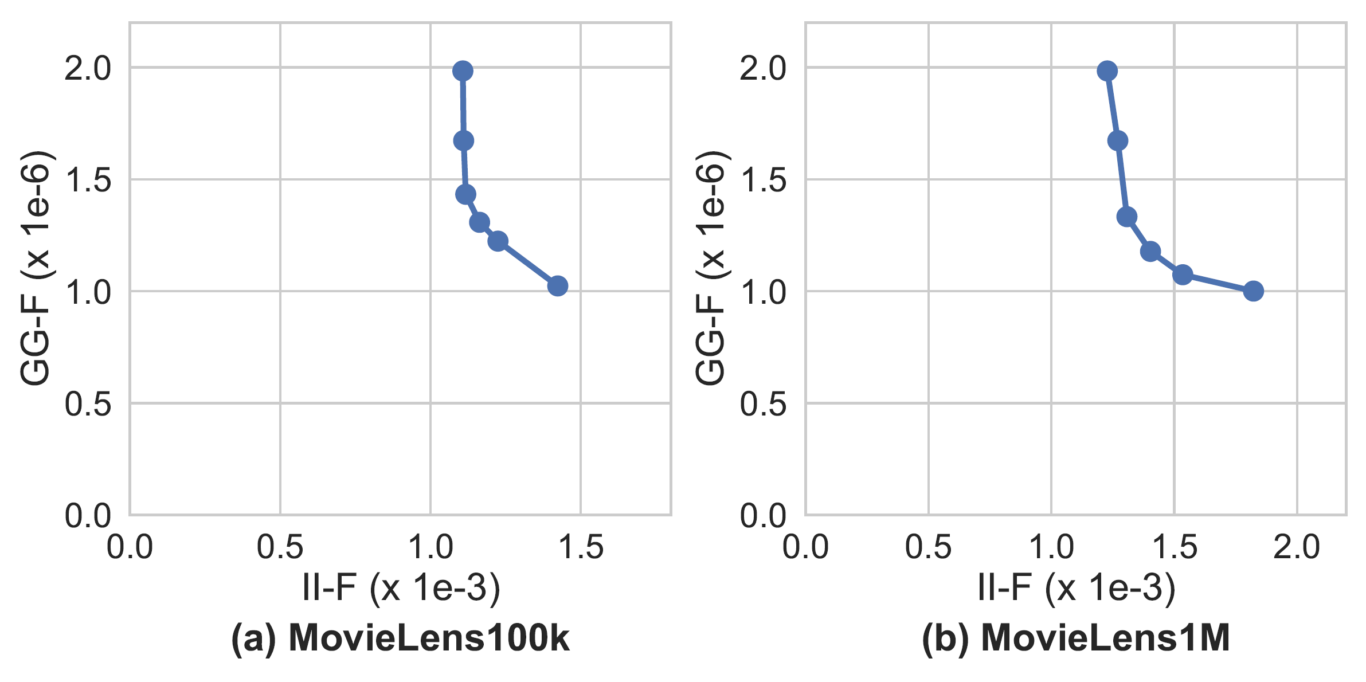
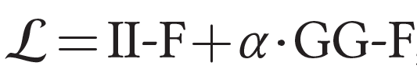
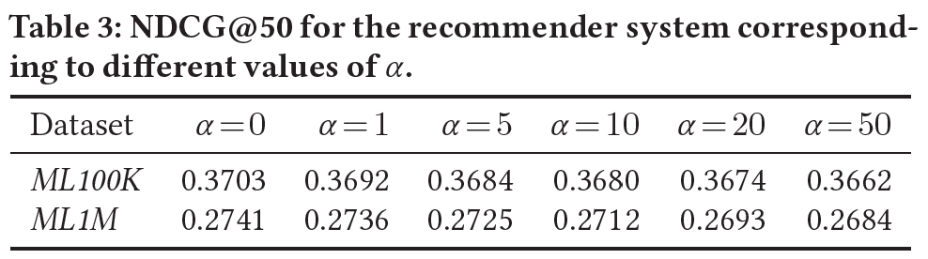
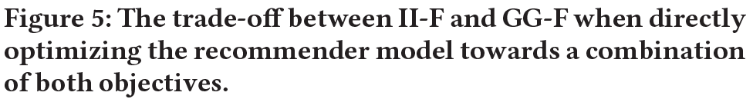
Trading-off different JME-fairness metrics
We can simultaneously optimize for multiple exposure metrics by combining them linearly
For example,
Preliminary experiments indicate that we can significantly minimize GG-F with minimal degradation to II-F and relevance

Slide 27
Thank you!

